Slide 1
Trends in ridership
Anthony Cofield
August 5, 2021

Slide 2
Goals
Understand how annual members and casual user differ in cyclistic bike rider usage
Analyze ridership patterns from the past 12 months (July 2020 - June 2021)
Throughout typical week
Throughout the year
Turn findings into marketing strategy to boost annual memberships

Slide 3
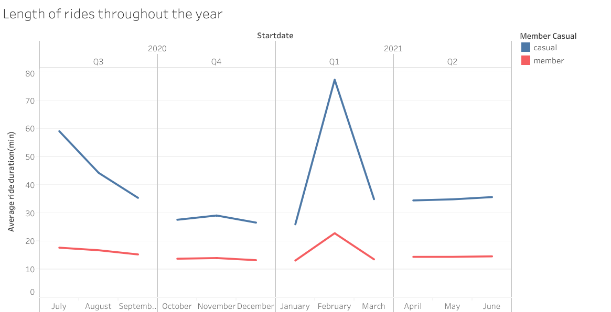
Trends in length of rides throughout past 12 months
Casual users’ average ride duration is 2x members’ average duration
Casual users’ duration varies more than members’ duration
Notes:
The average duration of rides from casual users were twice as long as members’ average duration throughout the year.
Members’ average duration was mostly consistent throughout the year. Casual users duration varied during Q3 2020 but was consistent Q4 2020 and Q2 2021.
ANOMALY: Duration for both user types peaked during February which is most likely do to weather conditions during that month.

Slide 4
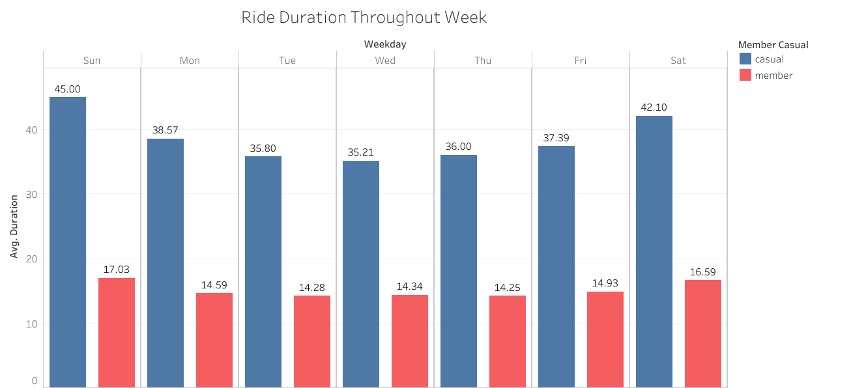
Trend in duration for each days of the week
Casual users ride duration peaks during the weekend
Member users duration is shorter but more consistent throughout the week
Notes:
Members’ average ride duration was lower and more consistent throughout the week.
Casual users’ average ride duration varies slightly during the weekdays but rises on Friday and peaks during Saturday and Sunday.

Slide 5
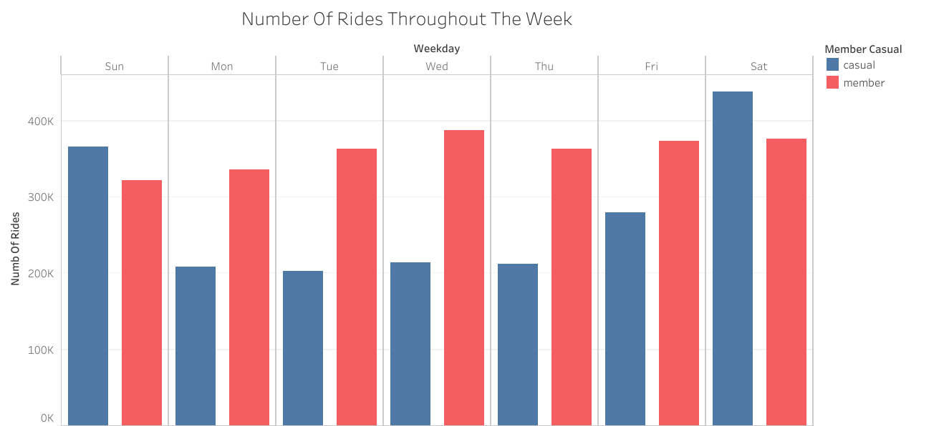
Number of rides for each days of the week
Number of rides from members are higher and more consistent
Number of rides from casual users peaked heavily during the weekend
Notes:
The number of rides from members were mostly consistent throughout the week, slightly peaking on Wednesday.
Ridership from casual users were lower than members’ ridership during the weekdays but peaked higher than member ridership on Saturday and Sunday.

Slide 6
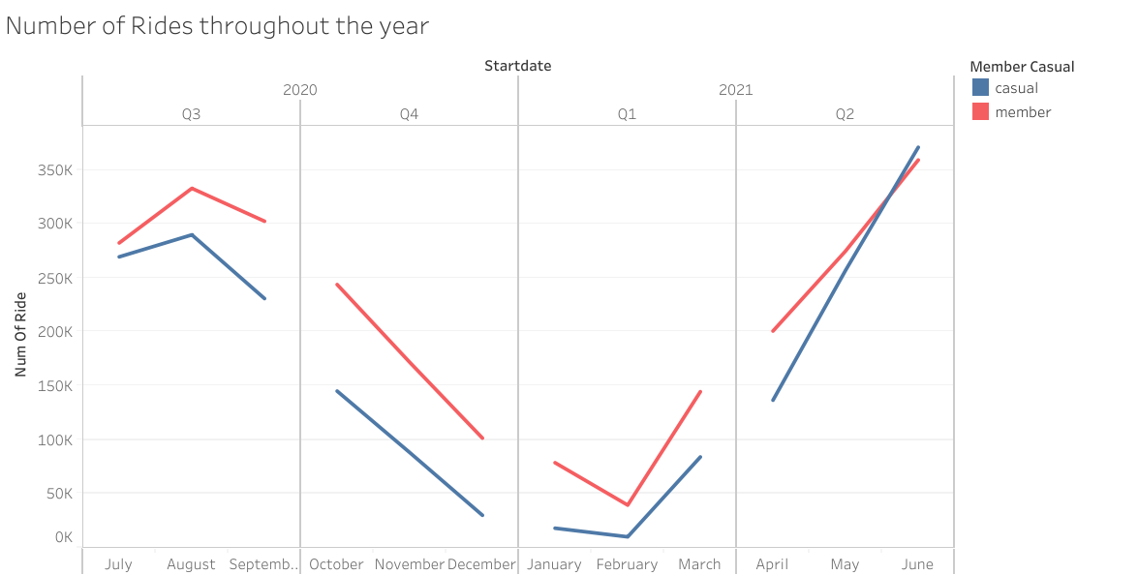
Number of rides throughout past 12 months
Members’ ridership was higher than casual users
Gap between ridership widens in Q3 and shrinks in Q2
Notes:
Ridership for both user types vary throughout the year. The number of rides for members was higher than casual users for all months except June 2021. The gap between the member and casual users’ ridership widened in Q3 2020 and shrunk in Q2 2021 to casual users ridership peaked over members ridership. Gap in ridership stayed steady during Q4 2020 and Q1 2021 with the exception of February.

Slide 7
Conclusion
Annual members most likely use this service to commute to work which would explain the consistent and low ride duration during the week.
Casual users’ average ride duration was over 25 minutes when averaged for each day of the week and each month.
Notes:
Annual members take more rides during the weekdays and their ride duration is consistent and twice as short than casual users ride duration throughout the week. This is most likely because members use our service to commute to work. THis is also evident from the fact that member ridership peaks on Wednesday.
Whereas casual users use this service more on the weekend most likely for leisure.
Casual users also rose more sharply during the summer which could be explained by tourist or students using our service during summer break.

Slide 8
Create marketing strategy that highlight cost saving benefits for rides longer than 20 min
Using our service is an eco friendly mode of transport to and from work

Slide 9
Appendix

Slide 10
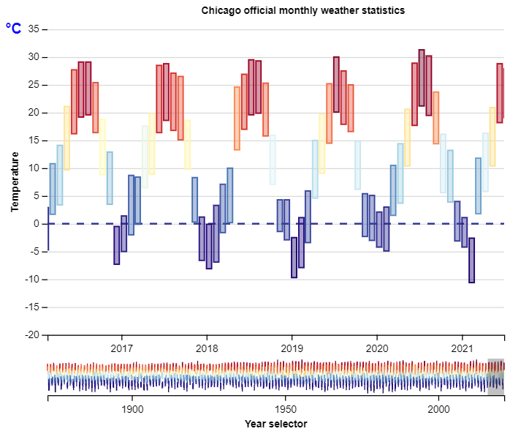
Anomaly in February ride duration
The spike in average duration of rides during February was believed to be because of snowy weather conditions. This was further backed up by data from Chicago’s O’ Hare International Airport.
February 2021
https://en.wikipedia.org/wiki/Climate_of_Chicago
Notes:
February was the coldest month in Chicago in 2021 having an average high of -2.6 degrees C and 13 snow days.

Slide 11
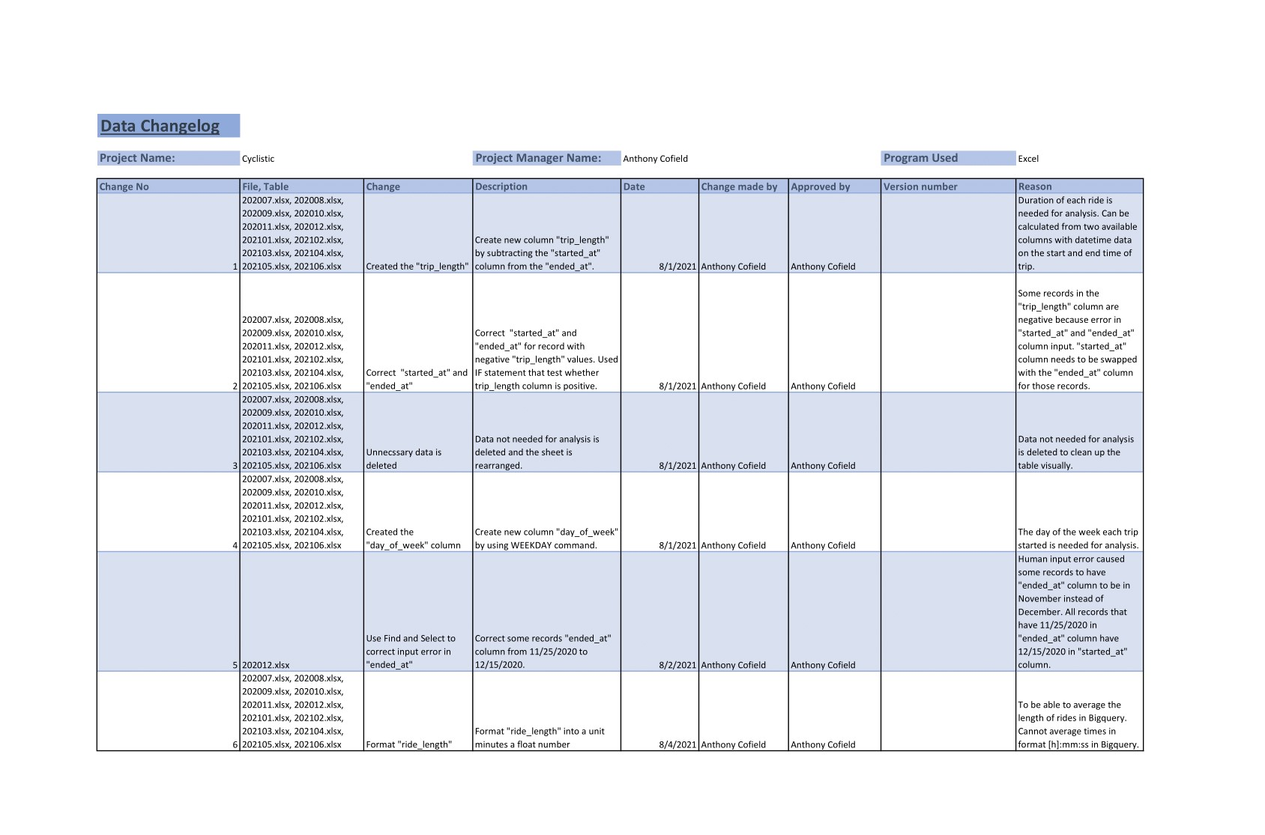
Changelog

Slide 12
Data Process
Query to find average ride duration and the total ride count for each day and each user type:
SELECT
DISTINCT DATE(started_at) AS startdate,
COUNT(ride_id) AS num_of_ride,
member_casual,
EXTRACT(DAYOFWEEK FROM started_at) AS day_of_week,
AVG(ride_length_min) AS AVG_ride_length_min
FROM `case-study-1-cyclistic-321502.cyclistic.202*`
GROUP BY
member_casual,
startdate,
day_of_week
ORDER BY
startdate
12 csv files contain data from the past 12 months on Cyclistic bike rides
Cleaned using Microsoft Excel
Data files were then uploaded to Bigquery for analysis
After exploring the data the query shown to the left was used to aggregate the number of rides and length of ride for each user type for everyday in the time period analyzed (July 2020 - June 2021) into a new table
The aggregated summary table was then imported into Tableau to create visualizations.

Slide 13
Data Process cont.
RStudio was used to import, clean, and aggregate the ride data
The data was aggregated into two files, one for analysis on each day of the week and another on each individual day.
The data was then analyzed visually with Tableau to see trends throughout the past 12 months for each day of the week and each month.

Slide 14
Questions?

